Slide 1

Unlock Your Learning Potential with StudyQuest-RAG
StudyQuest-RAG: Your AI-powered chatbot, revolutionizing how students interact with their study materials.

Slide 2





Introducing StudyQuest-RAG
AI-Powered Chatbot
Instant, intelligent answers
Context-Based Learning
Answers from your notes
PDFs & YouTube
Versatile input options
Accurate Retrieval
No more guesswork

Slide 3
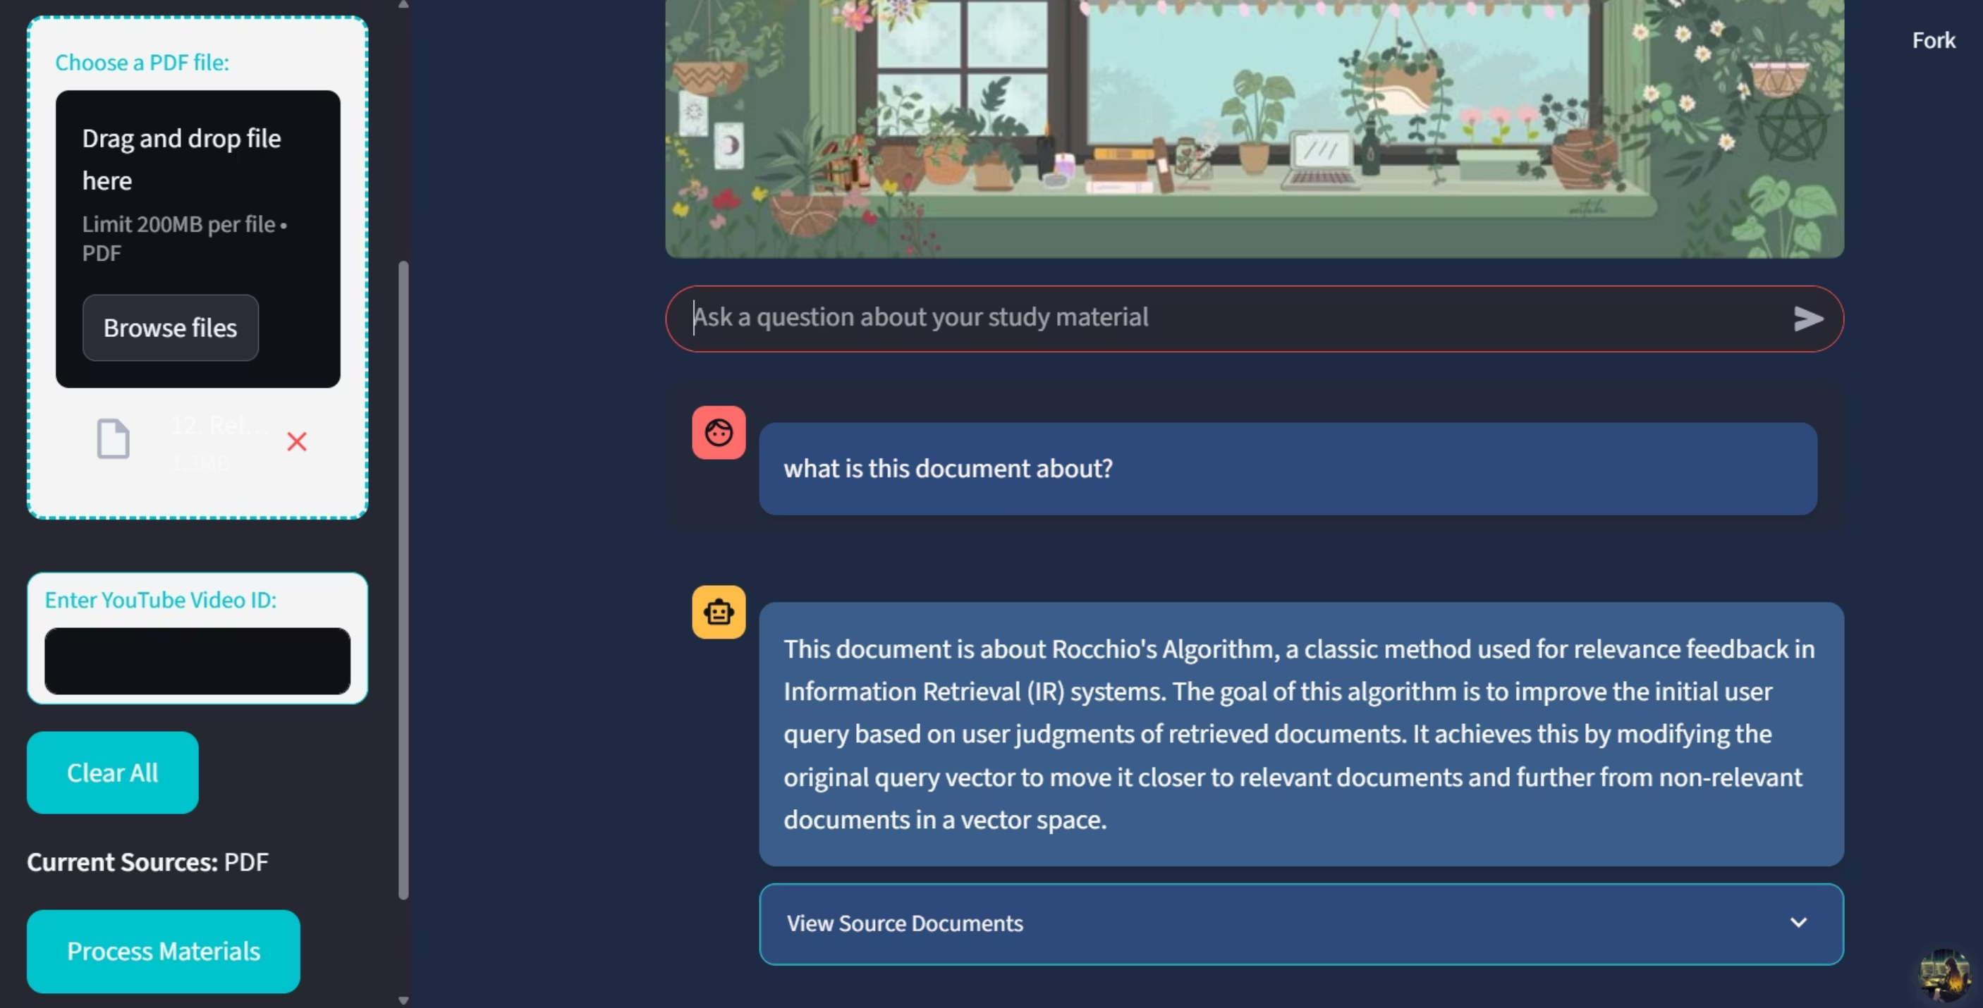
Study Lecture Notes

Slide 4
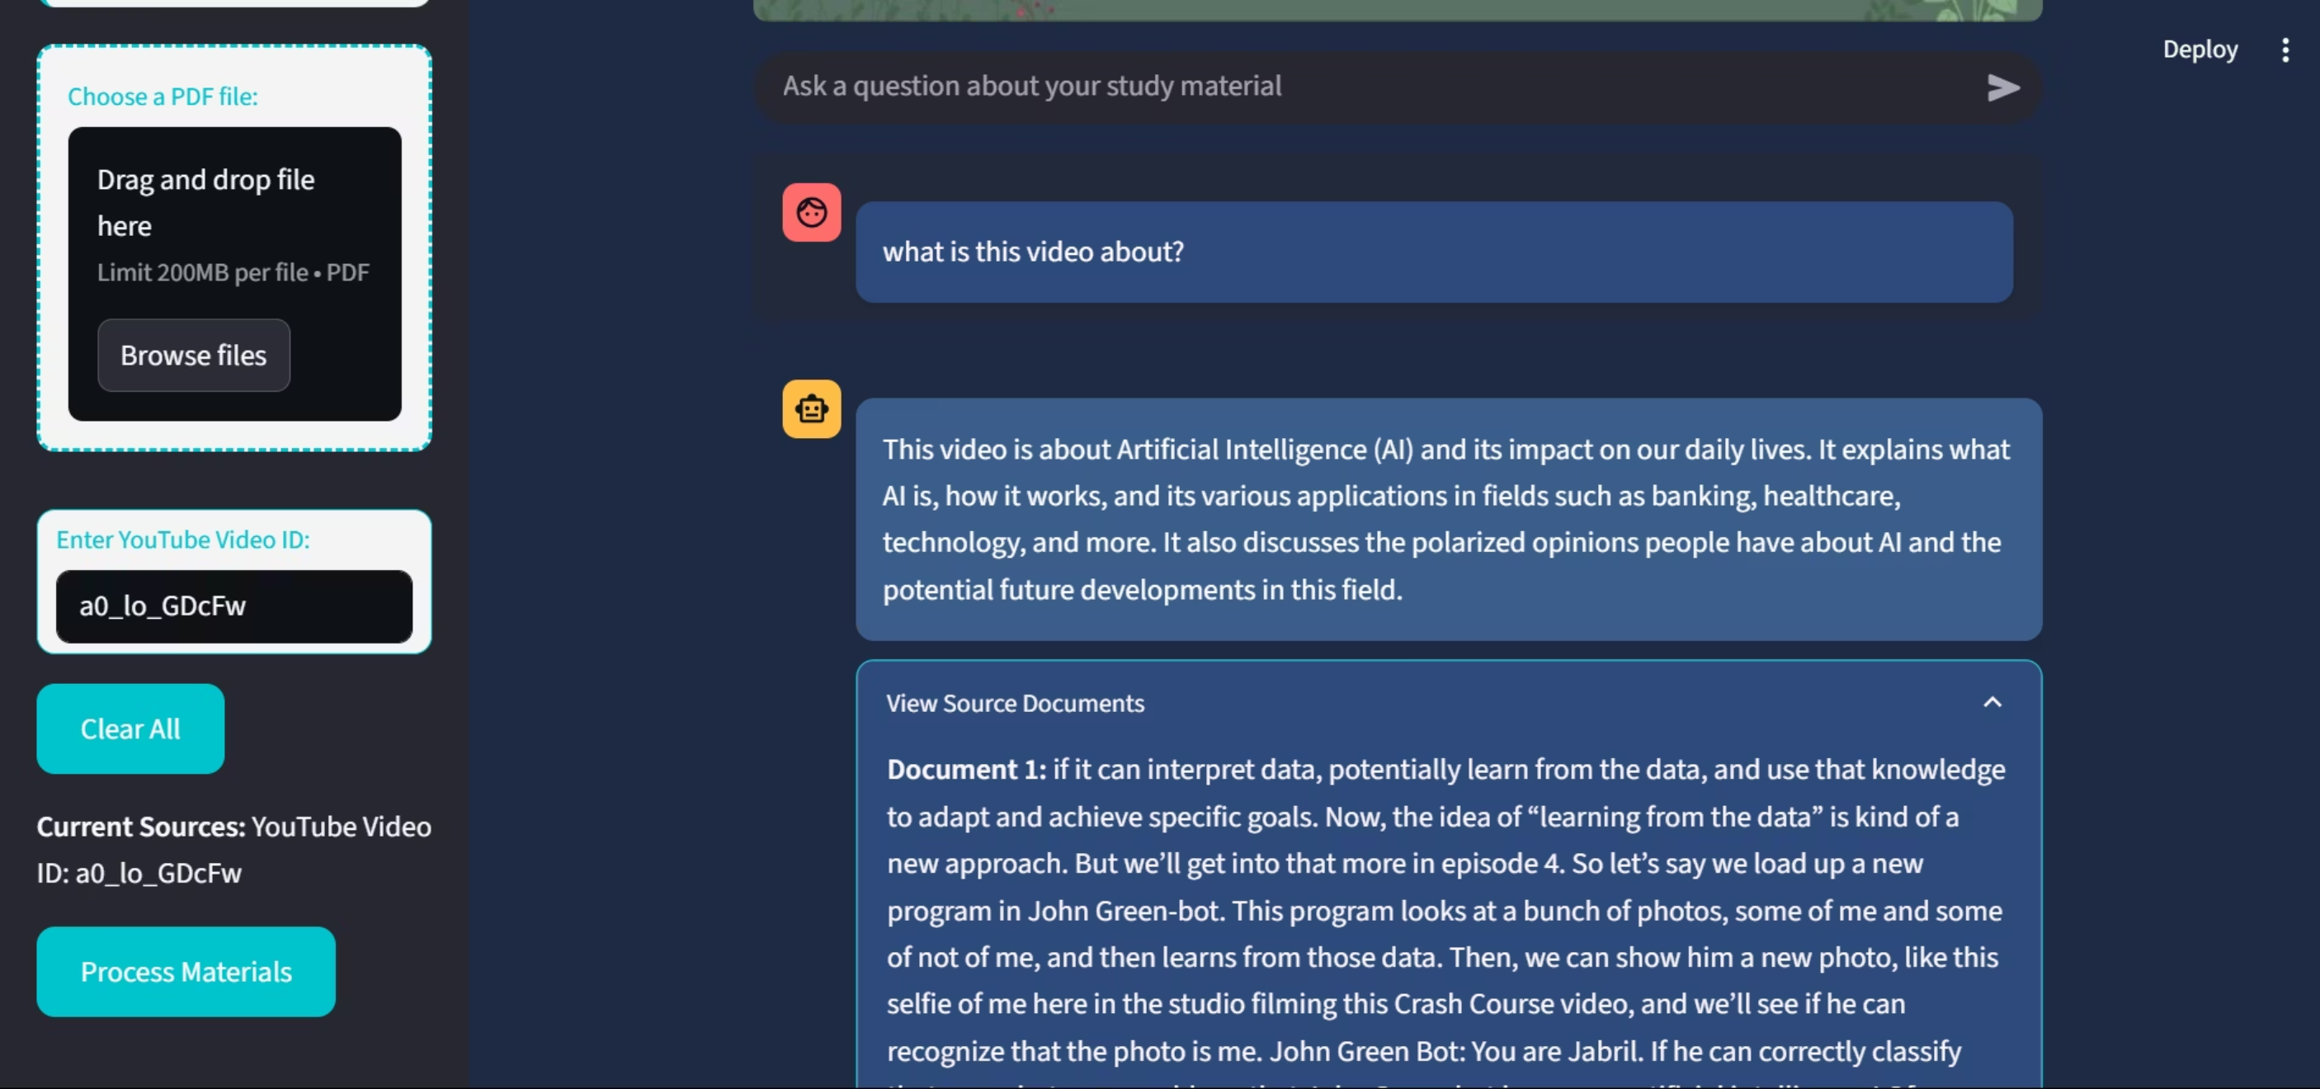
Study Lecture Videos

Slide 5
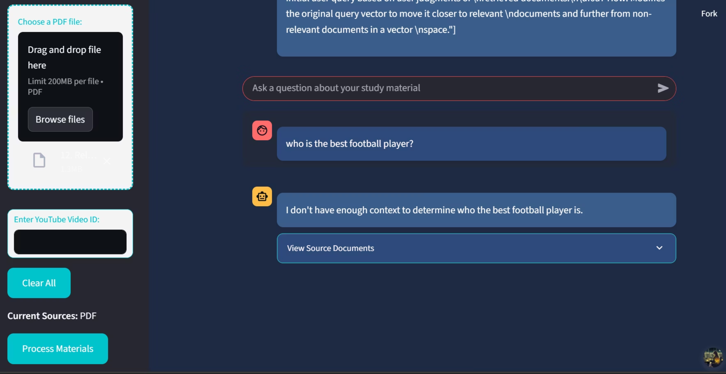
Doesn't Hallucinate

Slide 6




Understanding Retrieval-Augmented Generation (RAG)
Retrieval Phase
Finds relevant study material chunks
Augmentation Phase
AI generates precise answers
Reliable Responses
Avoids made-up information

Slide 7
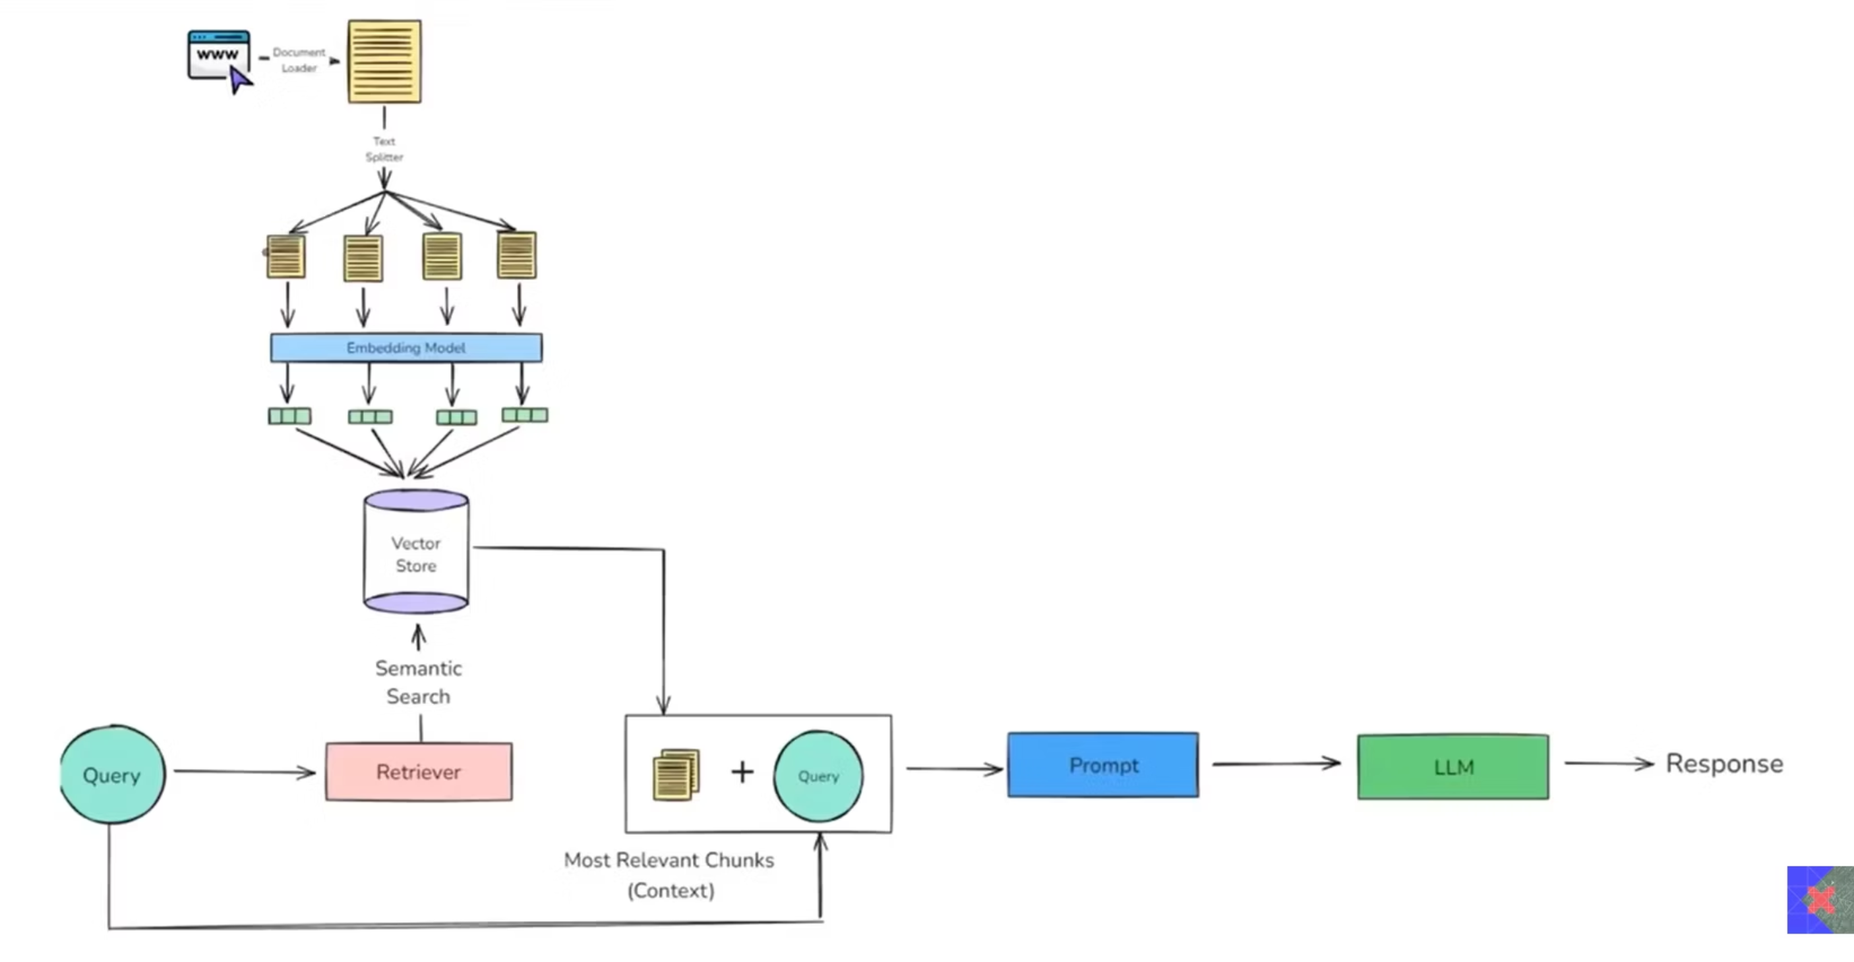
Workflow

Slide 8

How StudyQuest-RAG Works
Upload Your Materials
PDF notes or YouTube video ID
Process & Organize
App creates searchable library
Ask Your Questions
Utilize the intuitive interface
Receive Answers
Context-based, accurate responses

Slide 9
Key Features for Enhanced Learning
Dual Input Support: PDFs & YouTube transcripts
User-Friendly: Modern Streamlit interface
Transparency: Shows source documents
Session Management: Clear materials for new sessions

Slide 10
Behind the Scenes: Technology Stack
Streamlit
Intuitive web interface
LangChain
Manages AI & retrieval
FAISS
Fast search library
HuggingFace
AI models (Mistral-7B)
PyPDF, YouTube API
Processes various inputs

Slide 11

Why Choose StudyQuest-RAG?
Accurate Answers
Context-based from your materials
Time-Saving
Focus on learning, not searching
Enhanced Learning
Deeper material understanding
Reliability
Source-backed responses always

Slide 12

Demo & Future Vision
Experience StudyQuest-RAG Live
Upcoming Enhancements
studyquest.streamlit.app
Allow other documents(i.e, ppt, docs)
Remote app can process video transcript using proxy
Faster processing speeds

